Slide 1
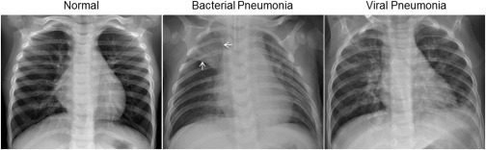

Classification of X-ray images using different models
LifeSavers
Garim Lee, Hyunwoo Kim, Moon-ki Choi, Won Joon Choi
CSCI 5523 - Spring 2021

Slide 2
Motivation
1. Machine learning (ML) model can quantify the progress the how far pneumonia has progressed
2. ML model as an assistance tool can prevent a mistake from the human expert.
3. ML model can capture the pneumonia from the x-ray image for other disease.
Figure 1. Illustrative Examples of Chest X-Rays in Patients with Pneumonia
Notes:
MK
Diagnostic of pneumonia through the chest X-ray image requires significant reliability because a mistake in this process brings hazardous impact on a patient. In this project, our team “lifesaver” will propose several diagnostic tools based on the machine learning model including what we learned from the lecture. Machined learning based diagnostic tools will bring a strong impact on the diagnostic of pneumonia because of three reasons.\\\\
1. Diagnostic tools can quantify the progress the how far pneumonia has progressed and diagnose the type of pneumonia whether it is caused by virus or bacteria
\vspace{2mm}
\\2. The tools can prevent the mistake from the human expert by providing additional features to diagnose the status of the chest of the patient.
\vspace{2mm}
\\3. Because of the convenience and quick test after the tool is settled, It can capture pneumonia from the x-ray image for other patients who intended to take the x-ray image for other diseases. \\\\
Throughout this project, we expect that the machine learning model will be able to diagnose pneumonia and its type quantitatively and which model is appropriate for screening pneumonia among the various models used in this project.

Slide 3
Data & Data pre-processing
Original
 | Normal | Pneumonia
Train | 1341 | 3875
Validation | 8 | 8
Test | 234 | 390
Balanced
Unbalanced
 | Normal | Pneumonia
Train | 1241 | 1241
Validation | 108 | 108
Test | 234 | 234
 | Normal | Pneumonia
Train | 1239 | 3773
Validation | 110 | 110
Test | 234 | 390

Slide 4
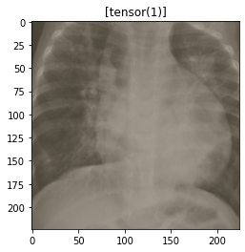
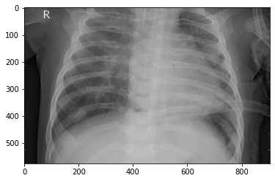
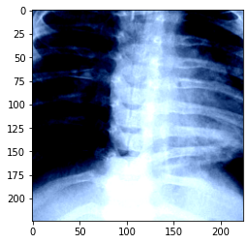
Example of the original and transformed image
SVM and ANN
CNN and Transfer learning

Slide 5
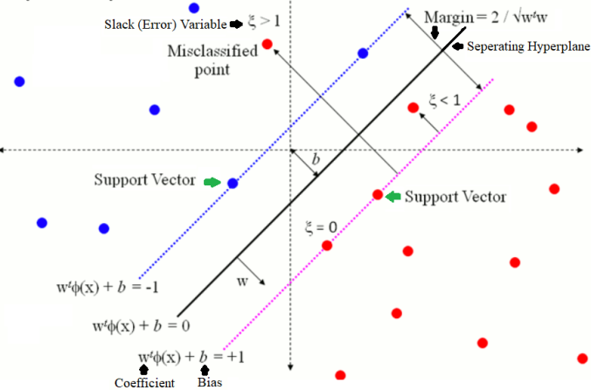
Support Vector Machine (SVM)
SVM complexity
Kernel (Gaussian RBF)
Parameters C (1), Gamma (0.005)
SVM Advantages and disadvantages
Highly accurate & Less overfitted
Expensive computation & classification

Slide 6
Artificial Neural Network (ANN)
Time, computational complexity → Grayscale (vs. RGB)
Activation function: RELU
Batch size = 1
Epochs = 15
Learning rate = 0.001
Forward propagation & backpropagation
Input
layer
4 hidden
layers
output
layer
. . .
. . .
. . .
. . .
2
. . .
224*224
256
128
128
64
Notes:
GL
As you all know, ANN is a powerful classification model for highly complex data inspired by biological neural networks. For our project, we used multi-layer neural networks with 4 hidden layers because multi-layer ones perform well with any type of classification such as learning non-linear functions.
Because ANN has a high time and computational complexity we used transformed images to grayscale rather than RGB.
After all hyperparameters were set as shown in this slide, while RELU was used for the activation, loss and accuracy were computed during training and validation steps with forward and backward propagation. The model with the highest validation accuracy was selected as a final model. We are planning to further go through various designs like different hyperparameters or different numbers of nodes.

Slide 7
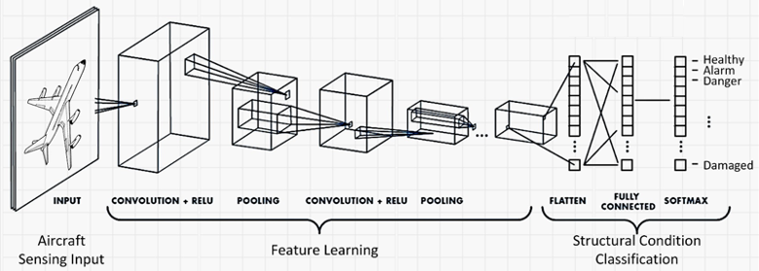
Convolutional Neural Network (CNN)
CNN can reduce the size of image data while keeping important features.
Combination of 2d convolutional layer and pooling is a key point.

Slide 8
Convolutional Neural Network (CNN)
Model specification
Batch size = 16; Dimension of data = 3; Number of epoch = 5
2D convolutional layer (input dimension = 3, output dimension = 3, kernel size = 4)
2D Max pooling (kernel size = 4)
2D convolutional layer (input dimension = 3, output dimension = 3, kernel size = 4)
1st Linear transformation (input size = 507, output size = 128)
2nd Linear transformation (input size = 128, output size = 64)
3rd Linear transformation (input size = 64, output size = 2)

Slide 9
Transfer Learning
GoogleNet, ResNet18
Notes:
WJ

Slide 10
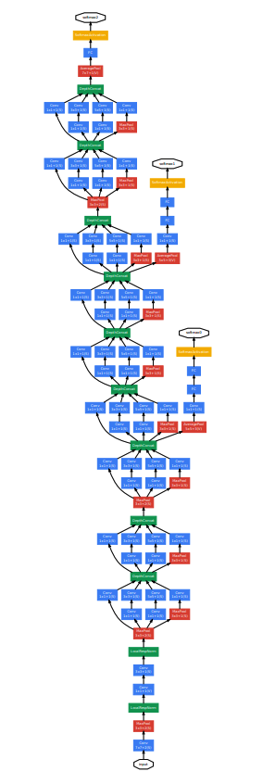
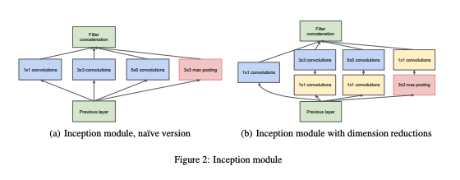
GoogleNet Architecture
Deep neural network
22 layers
“Inception” module
Batch normalization
4 million parameters (60 million for AlexNet)
Notes:
WJ
An Inception Module is an image model block that aims to approximate an optimal local sparse structure in a CNN. Put simply, it allows for us to use multiple types of filter size, instead of being restricted to a single filter size, in a single image block, which we then concatenate and pass onto the next layer.

Slide 11
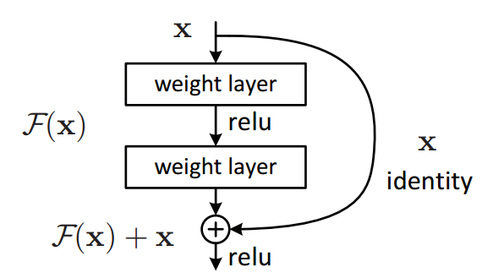
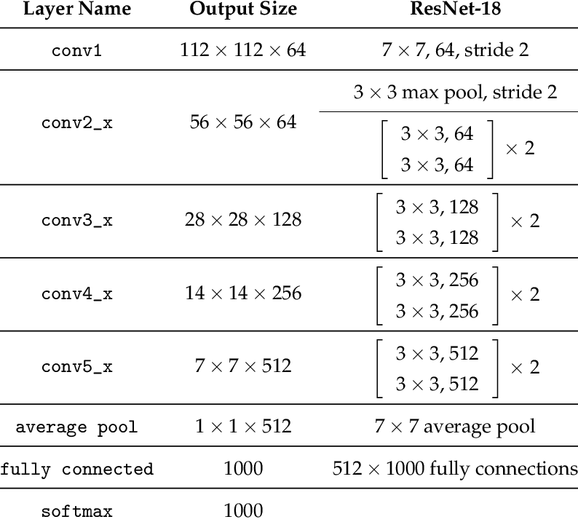
ResNet
Different layers: 18, 34, 50, 101, 152
Residual learning
Batch normalization after each convolution
Notes:
WJ
If the added layers can be constructed as identity mappings, a deeper model should have training error no greater than its shallower counterpart.

Slide 12
Test accuracy
 | SVM | ANN | CNN | ResNet
Balanced DataSet | 0.761 | 0.759 | 0.770 | 0.821
Unbalanced DataSet | 0.765 | 0.800 | 0.802 | 0.886
Highest test accuracy: ResNet
Test accuracy on Balanced vs. Unbalanced data
✱ Future works: Try various designs!
Notes:
Overall, we found that ResNet has the highest test accuracy for both balanced and unb dataset.

Slide 13
Thank you for watching!
References
Tan, P. N., Steinbach, M., & Kumar, V. (2016). Introduction to data mining. Pearson Education India.
Kermany, D. S., Goldbaum, M., Cai, W., Valentim, C. C., Liang, H., Baxter, S. L., ... & Zhang, K. (2018). Identifying medical diagnoses and treatable diseases by image-based deep learning. Cell, 172(5), 1122-1131.https://doi.org/10.1016/j.cell.2018.02.010

